Slide 1
Title 16 Permitting or There are fish where I want to work! What do I do?
Alaska Department of Fish and Game
Audra Brase
Regional Supervisor
Fairbanks

Slide 2
Today
When do you need a Title 16 permit?
Alaska statute & regulation
Basic process to acquire a Fish Habitat Permit (Title 16).
Example of an application & various projects.
Risks of not permitting & non-compliance.

Slide 3
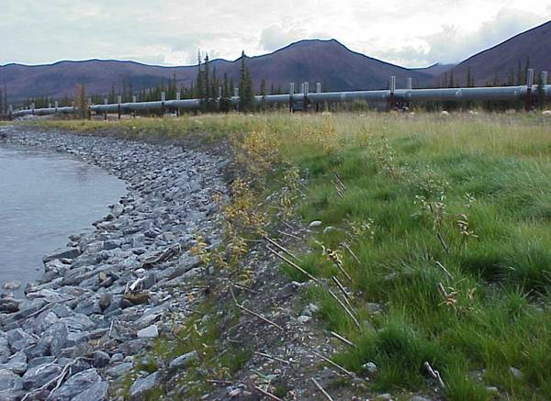
Habitat’s Mission: Properly protect Alaska’s valuable fish and wildlife resources and their habitats as Alaska’s population and economy continue to expand.

Slide 4
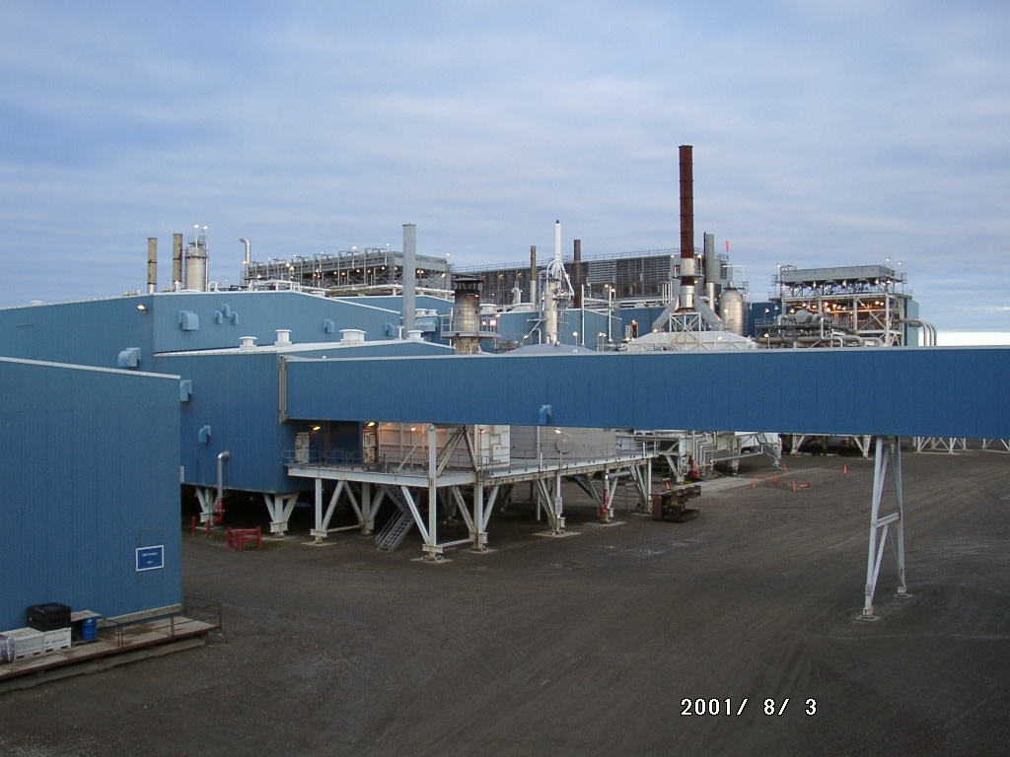
Alaska State Constitution Article VIII, Natural Resources
Endicott Island, Alaska
Auke Bay
Section 1 encourages land development and resource utilization.
Notes:
Our constitution is clear. Alaskan’s are to develop the land and utilize its resources.

Slide 5
Alaska State Constitution Article VIII, Natural Resources
Glacier Highway, Juneau
Steep Creek, Juneau
Section 2 includes conservation as a resource management objective.
Notes:
However, Alaskan’s must also conserve our natural resources.

Slide 6
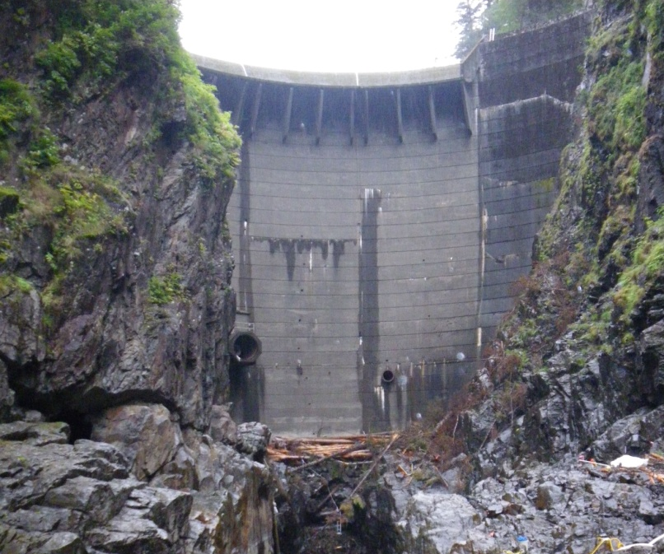
Alaska State Constitution Article VIII, Natural Resources
Blue Lake Hydro Dam, Sitka
Balance
(ADF&G, ADNR and ADEC)
Resource Development and Resource Protection
Notes:
So habitat biologists strive to find the balance between resource development and resource protection; similar to all other management biologists within the department.

Slide 7
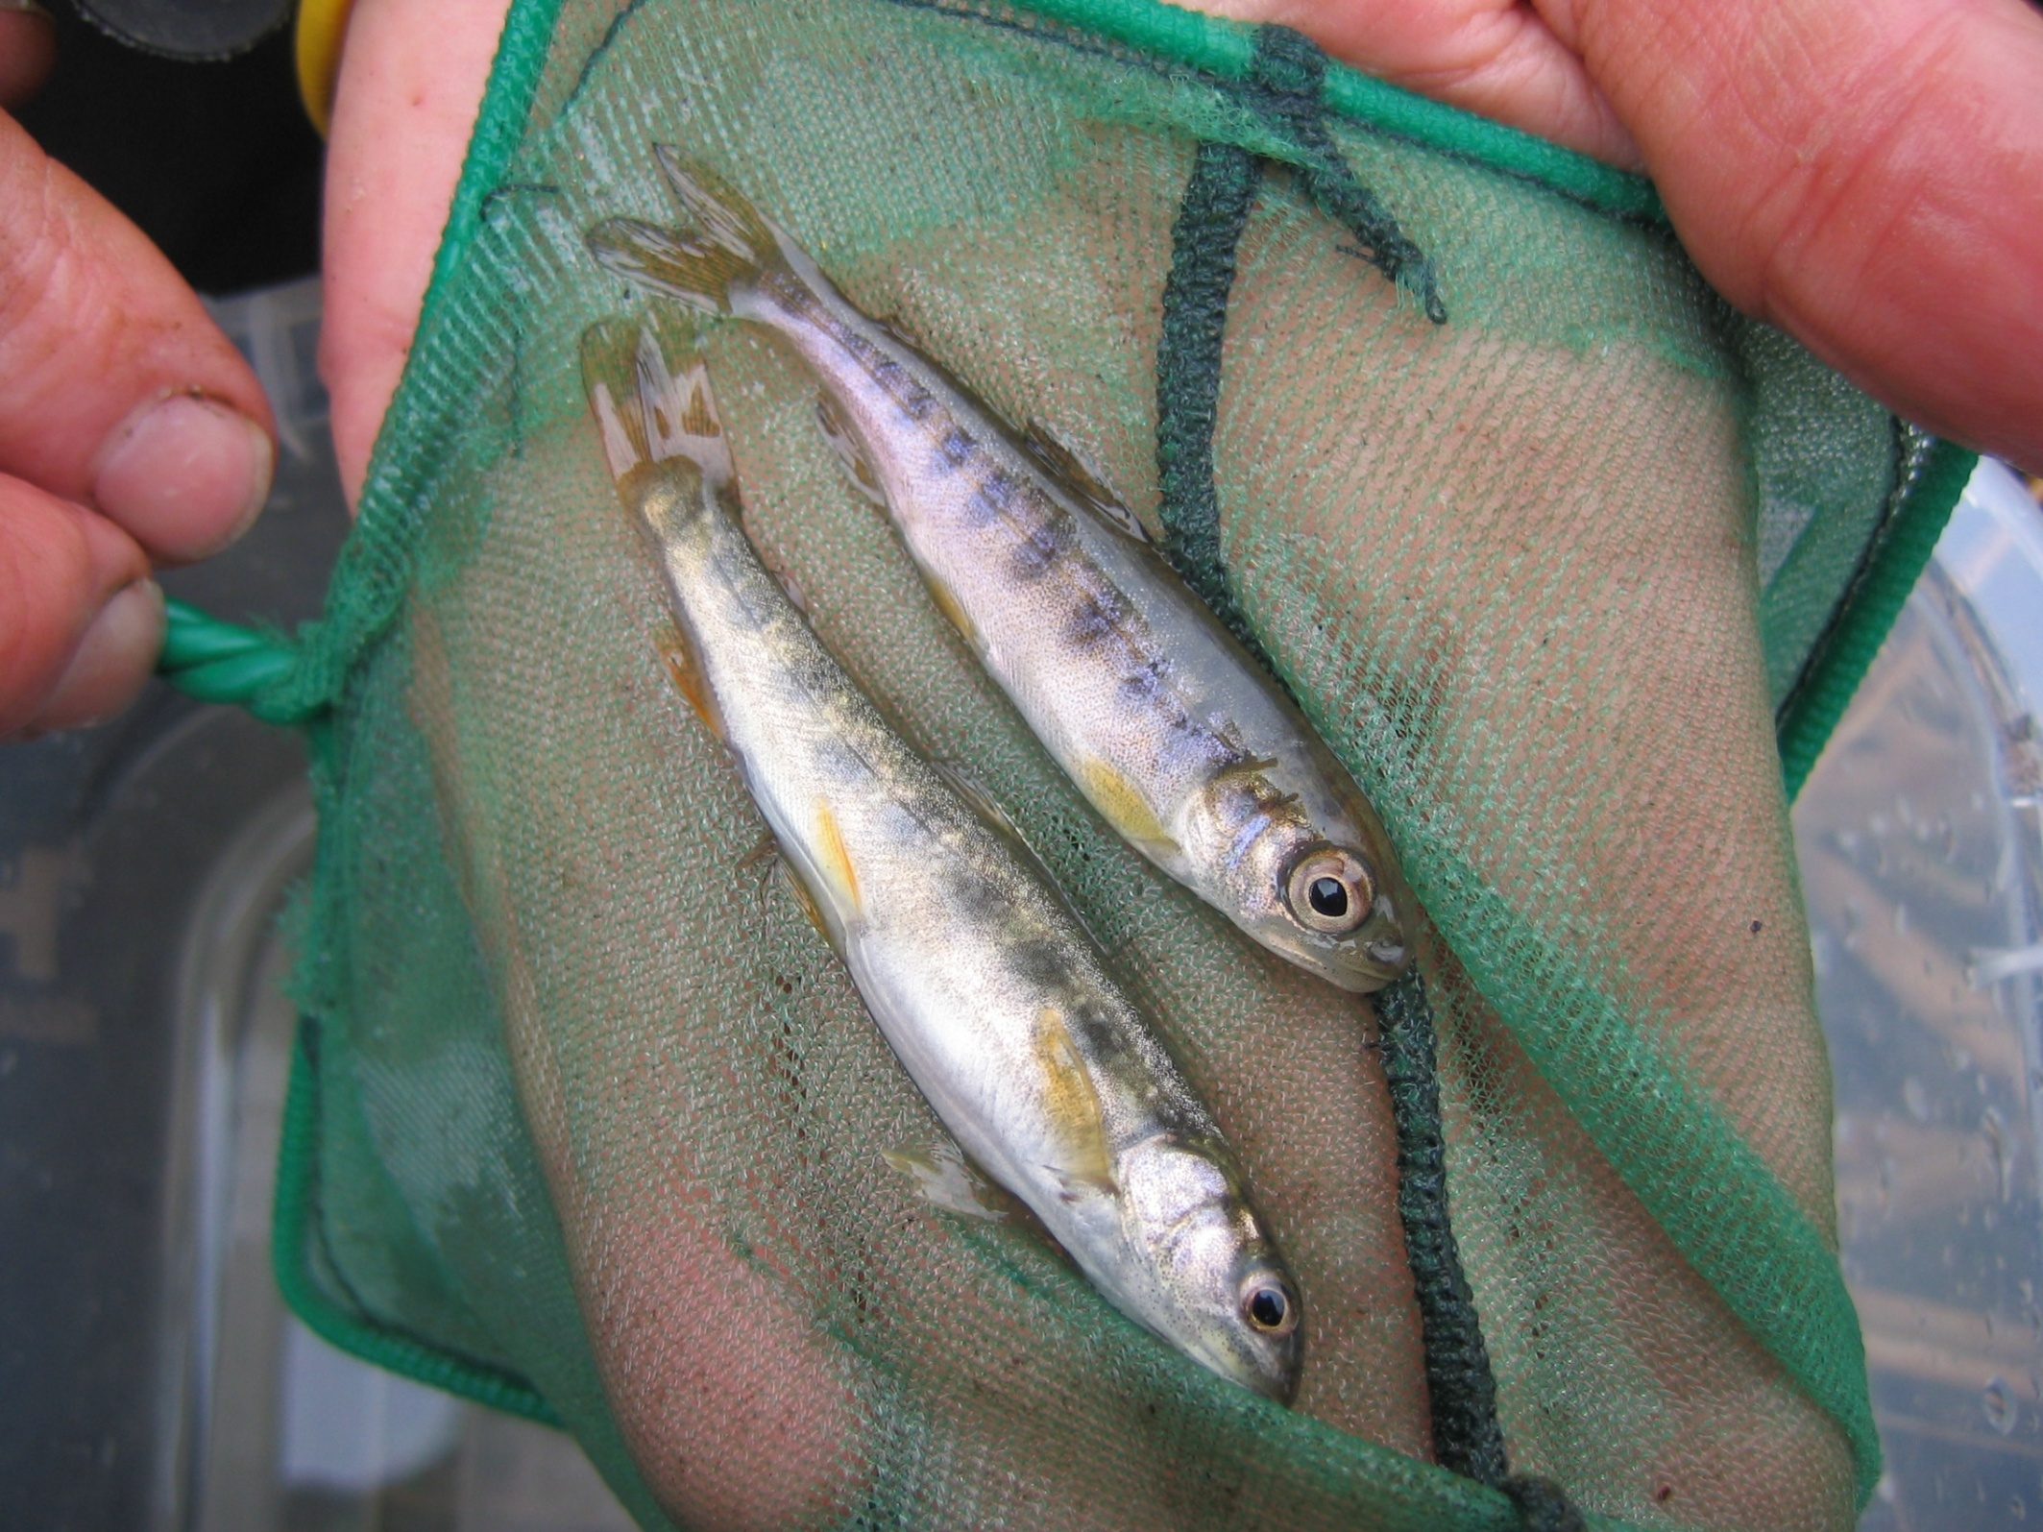
Balancing can be challenging
Notes:
As most resource managers can agree, balancing can be challenging. These are the questions I hope to answer for you today.

Slide 8
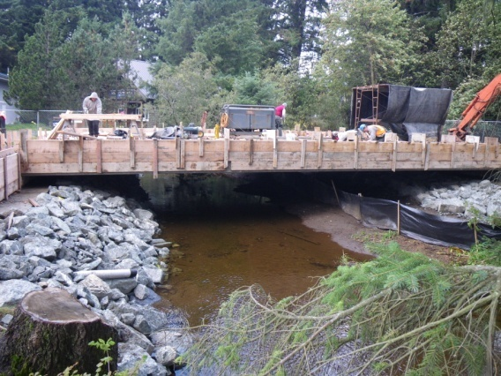
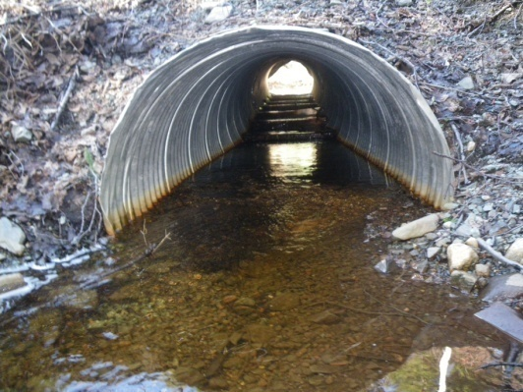
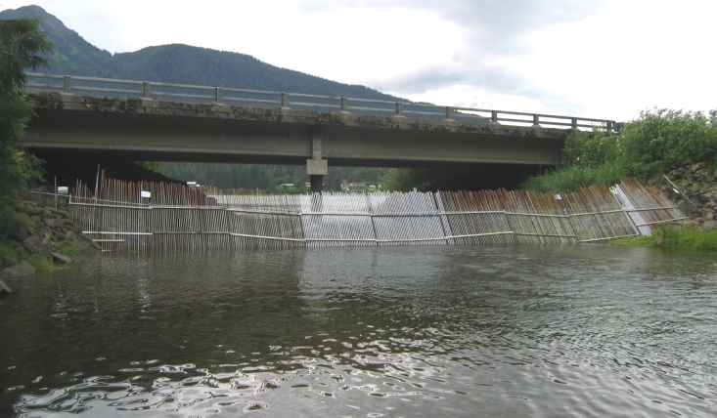
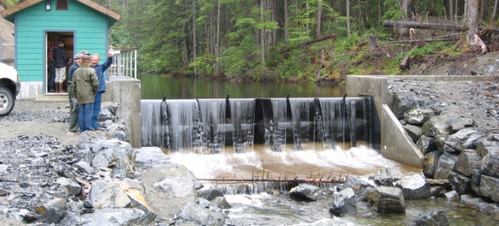
Title 16: Fish Passage (.841)and Fish Habitat (.871) Permitting
water withdrawals
bridges
suction dredging
crossings
culverts
bank stabilizations
dams
fish weirs
Notes:
Vehicle/ equipment stream crossings
Water withdrawals (from fish bearing water bodies)
Stream diversions
Instream construction & maintenance (bridges, culverts, docks)
Gravel mining
Small scale recreational mining (suction dredges)
6 inch or less, 18 hp or less
Bank stabilization/ rehabilitation

Slide 9
How do I know if there are fish in the river/ lake?
Call your local ADF&G Habitat office
Fairbanks – 459-7282
ADF&G website
Fish Resource Monitor
Anadromous Waters Catalog (AWC)
Paper maps in most ADF&G offices

Slide 10
Habitat Offices
Notes:
Habitat Regions
Each region unique issues & differing activities
Interior/Northern – placer, oil & gas, hard rock mining (large projects - Red Dog, Ft Knox, Pogo, Usebelli)
Mat-Su – placer, roads
Anchorage/SW – roads, Special Areas
SEAK – timber, Special Areas, hard rock mines (large projects – Kensington, Greens Creek)

Slide 11
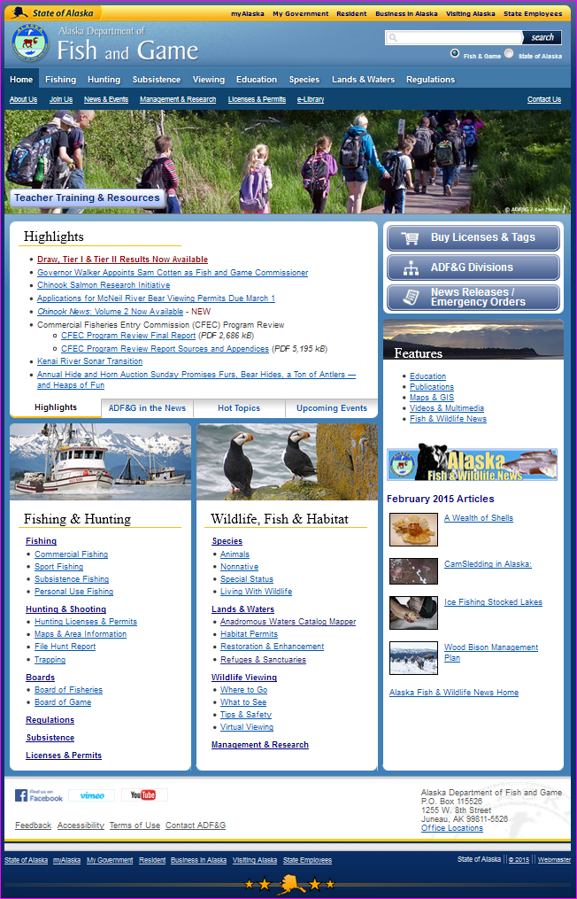
ADF&G Home Page adfg.alaska.gov
🡻
Habitat
🡻
Anadromous Waters Catalog Mapper
Notes:
The official way to get to the online catalog is from the ADF&G home page.

Slide 12
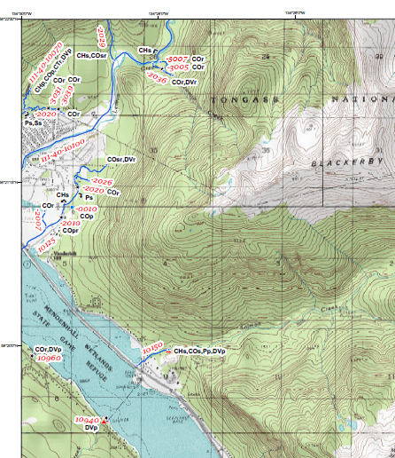

Slide 13
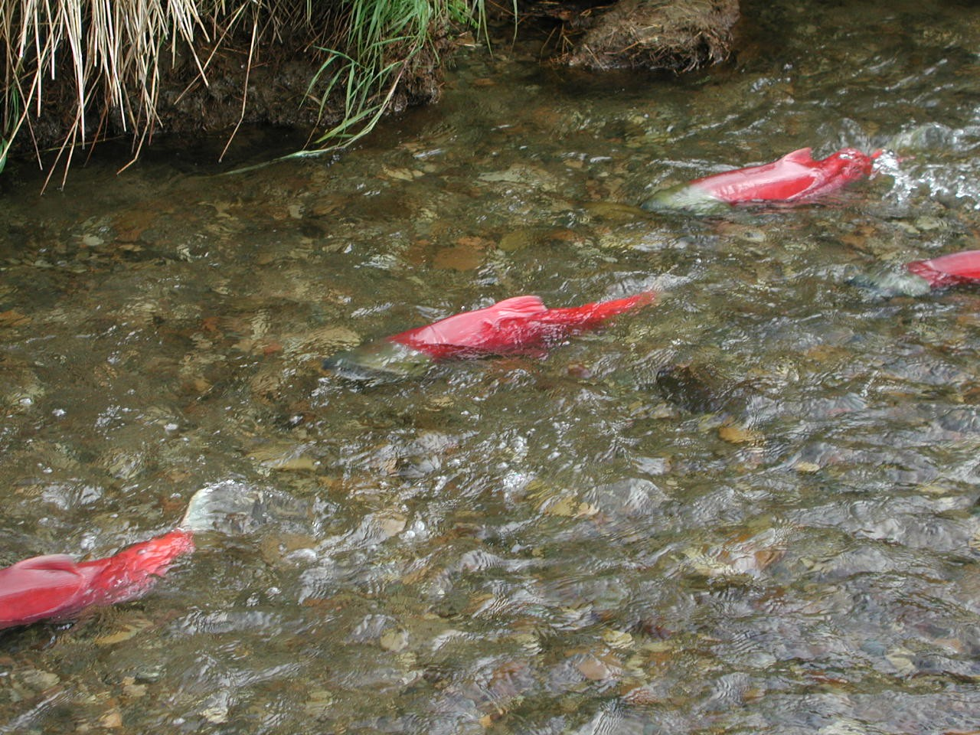
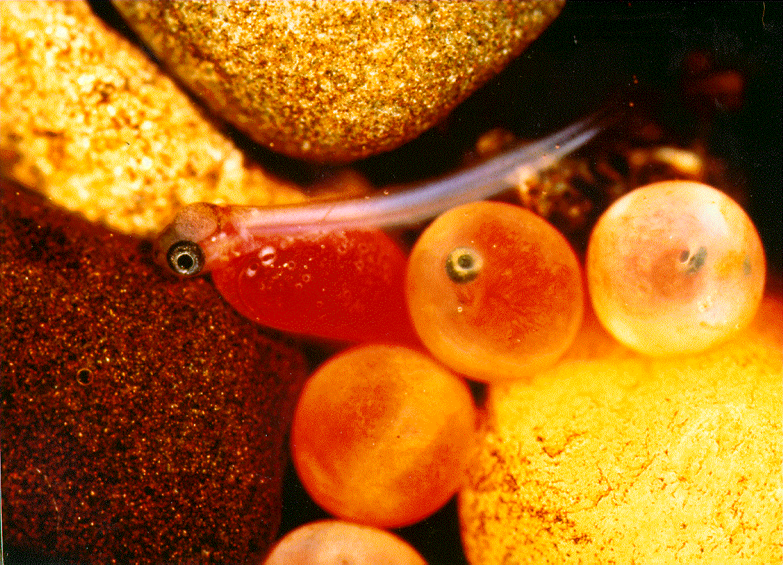
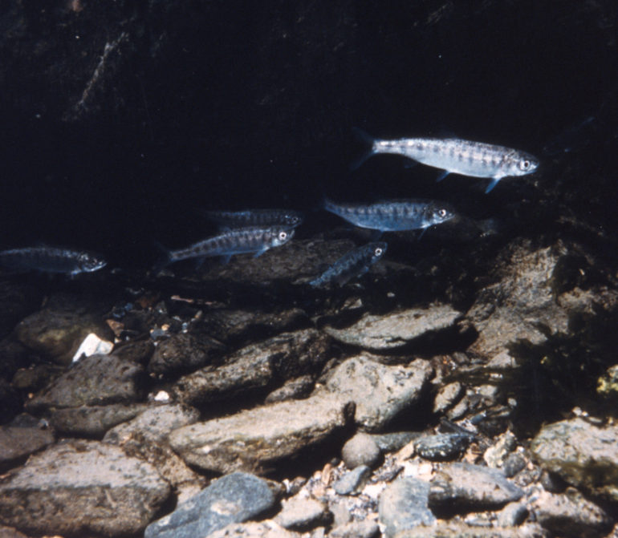
Categories of Fish Use
Spawning
Rearing
Migration
“Present”

Slide 14
Habitat Statutory Authority
THE FISHWAY ACT
AS 16.05.841
ANADROMOUS FISH ACT
AS 16.05.871
Notes:
In 1959, the legislature enacted a Fish and Game Code that included statutory protections for fish passage and later fish habitat.
Three pieces to our permitting authority
In addition to the authorities delegated to the Division of Habitat for fish passage and fish habitat protection, the Division of Sport Fish also has authority to regulate the handling (Fish Resource Permit (FRP)) and transport of fish (Fish Transport Permit (FTP)).

Slide 15
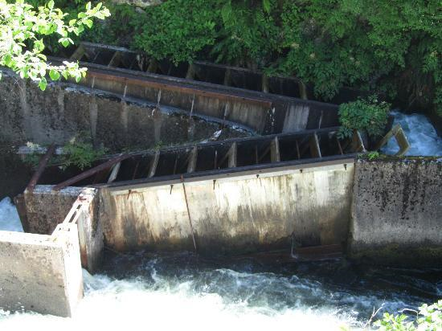
Fishway Act (aka .841)
AS 16.05.841. Fishway required.
“…every dam or other obstruction built by any person across a stream frequented by salmon or other fish shall be provided by that person with a durable
and efficient fishway and
a device for efficient passage
for downstream migrants. …
Notes:
The Fishway Act (or .841) applies to any stream with fish and requires that anyone proposing to build an obstruction must provide fish passage around or through the obstruction. The Ketchikan Creek fish ladder is an example of a structure that would meet this criteria.
Other examples: dams, culverts, bridges, water withdrawals

Slide 16
Fishway Act, cont.
AS 16.05.841. Fishway required.
“…The fishway or device or both shall be maintained in a practical and effective manner in the place, form, and capacity the commissioner approves for which plans and specifications shall be approved by the department upon application. ....”
Notes:
The statute also requires that the fish passage device be maintained, kept open and unobstructed, and allow the free passage of fish.
Examples: beaver dam removals, debris build up after flooding, breaching ice bridges

Slide 17
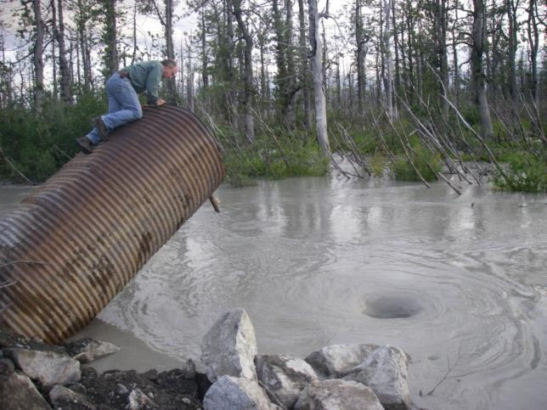
Fishway Act, cont.
AS 16.05.841. Fishway required.
“…The fishway or device shall be kept open, unobstructed and supplied with a sufficient quantity of water to admit freely the passage of fish through it.”
Notes:
The culvert shown clearly no longer meets the criteria of the Fishway Act.

Slide 18
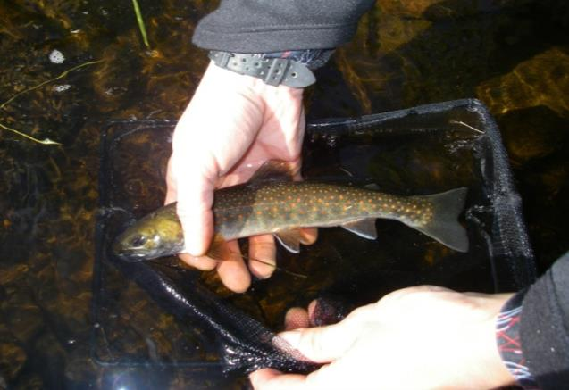
Fishway Act, cont.
Strengths
Applies to all fish bearing streams (resident and anadromous) and all fish species.
Requires fish passage be maintained for the life of the structure.
Limitations
Applies to fish passage only.
Notes:
The primary strength of the Fishway Act is that it requires passage for all species of fish. If a structure such as a culvert is authorized, the structure has to maintain fish passage for the life of the structure.
The primary limitations of the statute are that it addresses fish passage only, so if a project affects habitat in any way beyond fish passage, we have no authority to address that under .841.

Slide 19
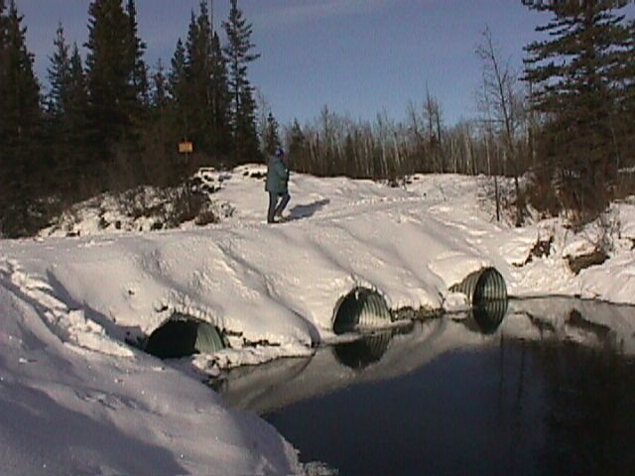
Fish Passage
Upstream or Downstream
Effects at All Life Stages
Flow Does NOT Necessarily Equate to Fish Passage

Slide 20
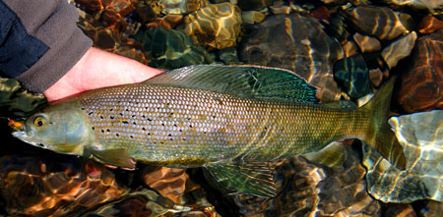
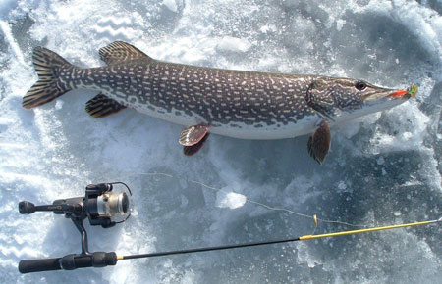
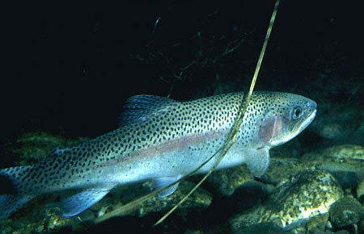
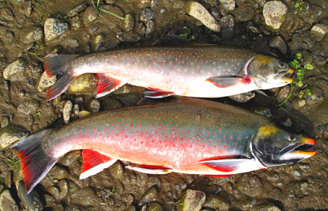
Other Resident Fish Species : sculpin, stickleback, blackfish, whitefish (round & humpback), least cisco, lake trout, burbot, sheefish

Slide 21
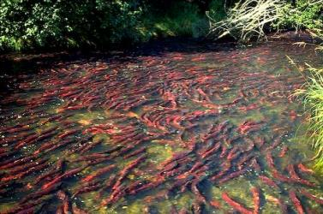
Anadromous Fish Act (aka .871)
AS 16.05.871. Protection of fish and game
(a) The commissioner shall…
specify the various rivers, lakes
and streams or parts of them
that are important for the
spawning, rearing or migration
of anadromous fish.
Notes:
The most well known of our statutes is referred to as the Anadromous Fish Act or “871”. The first part of the statute requires the Department to specify all the important freshwater anadromous habitat statewide. We have done that through the creation of and continued updates to the Anadromous Waters Catalog (AWC).
It is important to point out that anadromy refers to any fish that hatches in freshwater, travels to marine & then returns to fresh water. This is not just salmon, but also some species of whitefish, Dolly Varden, steelhead, cutthroat trout
From website: The AWC currently contains over 19,000 streams, rivers or lakes around the state which have been specified as being important for the spawning, rearing or migration of anadromous fish. Based upon thorough surveys of a few drainages it is believed that this number represents less than 50% of the streams, rivers and lakes actually used by anadromous species. It is estimated that at least an additional 20,000 or more anadromous water bodies have not been identified or specified under AS 16.05.871(a).
The AWC & maps are important because they specify which streams, rivers and lakes are important to anadromous fish species and therefore afforded protection under AS 16.05.871. Water bodies that are not "specified" within the Catalog and Atlas are not afforded that protection. To be protected under AS 16.05.871, water bodies must be documented as supporting some life function of an anadromous fish species (salmon, trout, char, whitefish, etc.) Anadromous fish must have been seen or collected and identified by a qualified observer. Most nominations come from F&G fisheries biologists. Others are received from private individuals, companies and biologists from other state and federal agencies.
There are numerous ways for the public to access the data available in the AWC. Online interactive mapper on our website that also included Fish Passage Inventory data and Freshwater Fish Inventory data. GIS layers are also available for download on our website in addition to KMZ files for viewing the AWC in Google Earth. PDF copies of the USGS topo quads used for the official Atlas Maps are also available.

Slide 22
Anadromous Fish Act, cont.
AS 16.05.871. Protection of fish and game
(b) If a person or governmental agency desires to construct a hydraulic project, or use, divert, obstruct, pollute, or change the natural flow or bed of a specified river, lake, or stream, or to use wheeled, tracked, or excavation equipment or log-dragging equipment in the bed of a specified river, lake or stream, the person …shall notify the commissioner of this intention before the beginning of construction or use.
Notes:
Activities requiring an 871 permit, note this specifically mentions the waterbody’s habitat (within OHW)

Slide 23
Anadromous Fish Act, cont.
AS 16.05.871. Protection of fish and game
(d) (paraphrased)…after receiving complete plans and specifications, the commissioner shall approve the proposed construction, work, or use in writing unless the commissioner finds the plans and specifications insufficient for the proper protection of fish and game. If plans are insufficient for proper protection, the applicant will be notified in writing and may initiate a hearing within 90 days of receiving the notice.
Notes:
871 applies to activities that are proposed in specified anadromous waterbodies. It requires that plans for work are submitted to the department for review, and we then decide to either issue a permit for the project as proposed, issue a permit with specific conditions and stipulations, or deny the permit.
I will detail this further later in the presentation how we work with the applicants.
“Proper Protection” – minimize impacts to the extent practicable, mitigate if habitat lost (remove stream barriers, increase off channel habitat, bank stabilize, etc..)

Slide 24
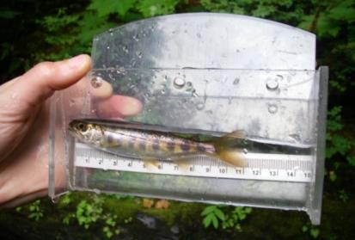
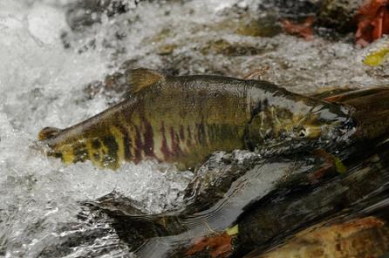
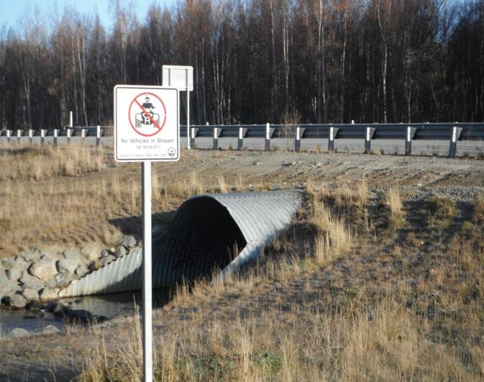
Anadromous Fish Act, cont.
Strengths
Applies to many activities.
Applies to any life stage.
Limitations
Jurisdiction typically limited to below OHW.
Waterbody must be in AWC.
Freshwater only.
Notes:
The primary strength of the Anadromous Fish Act is that it is broad in scope and applies to many activities below the OHW of anadromous waterbodies. For fish passage projects, this statute allows us to review designs and make decisions based on more than just fish passage. We can consider impacts to habitat or stream function and include requirements for streambank restoration and revegetation u/s and d/s of a new culvert.
Activities typically requiring an .871 permit include: docks, stream crossings, bank stabilization, bridges, utility crossings, culverts, etc.
Another limitation is that the waterbody must be included in the Anadromous Waters Catalog to be afforded protection under .871.
Finally, our authority is limited to freshwaters and some tidal areas. We have no jurisdiction in in the marine environment.
(remember FRPA allows for on the ground notice of fish for commercial forestry activities, doesn’t need AWC)

Slide 25
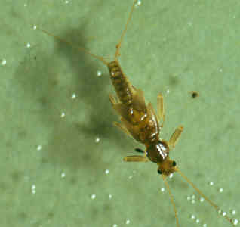
Anadromous fish species
Fish passage and habitat impacts (w/in ordinary high water)
FISH AND
HABITAT

Slide 26
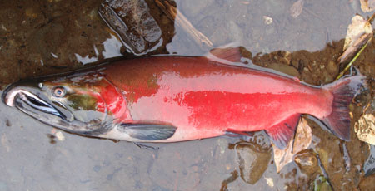
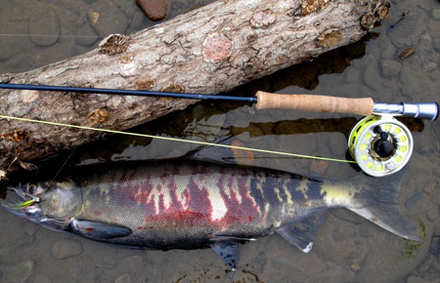
Other Anadromous Species: Sheefish, whitefish, lampreys

Slide 27
General Habitat Permitting Process
Notification of project proposal
Review application and supplemental documents to determine if Habitat has permit jurisdiction
No Issue “no permit required”
Yes
Determine what type of permit is required and what resources may be impacted
Special Area Permit
Fishway Act Permit
Anadromous Fish Permit
Identify Special Area purpose, policies, and allowable activities
Identify fish passage
Identify potential impacts to anadromous fish habitat
Work with applicant to incorporate avoidance and minimization measures into the proposed project
Issue permit with stipulation and mitigation requirements, if necessary
Deny permit if impacts can’t be adequately avoided, minimized, or mitigated
Notes:
General Flow Chart of Permit Process….next slide gives detail

Slide 28
Step 1 - Consultation
Contact your local office (phone, email or in person)
Describe the project
Location
Project Description
Timing (start time & duration)
Habitat Staff will evaluate what kind of permit is required (if any)
.871 or .841

Slide 29
Step 2 - Application
If a Fish Habitat or Special Area Permit is required
Fill out a FHP Application, or
Provide project information in an email,
or verbally (written is preferred!)
Provide enough information so the biologists can properly assess the project & its potential impacts
Photos are always appreciated for remote projects

Slide 30
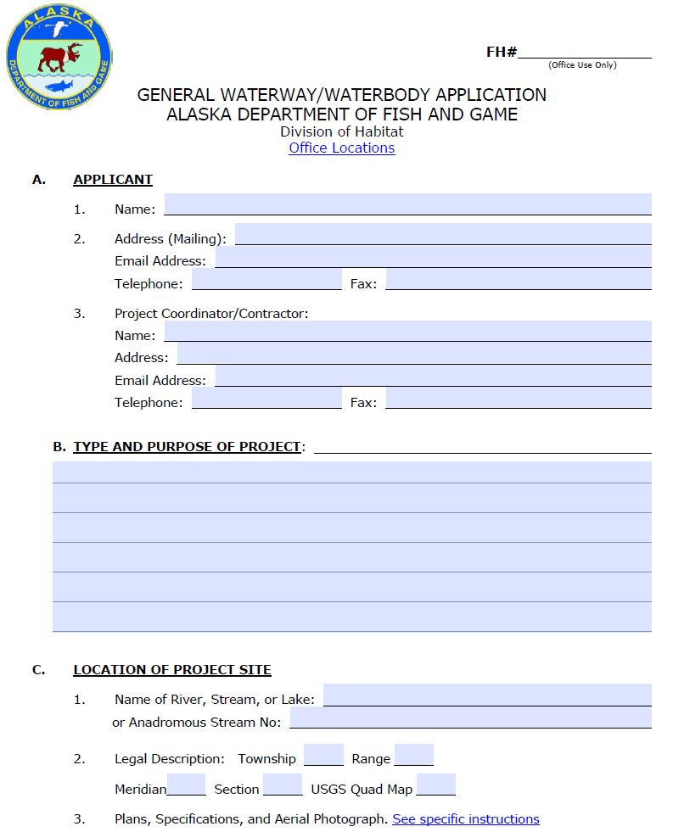
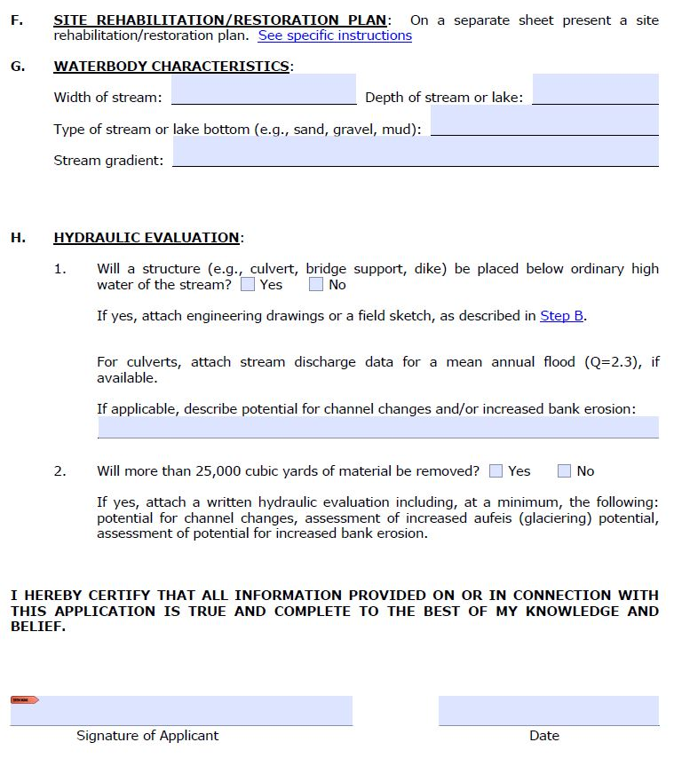
Fish Habitat Application
Notes:
Online ADF&G website, or can be included in an email, phone call or in person.
Contact Info
Description
Location
Time Frame
Methods

Slide 31
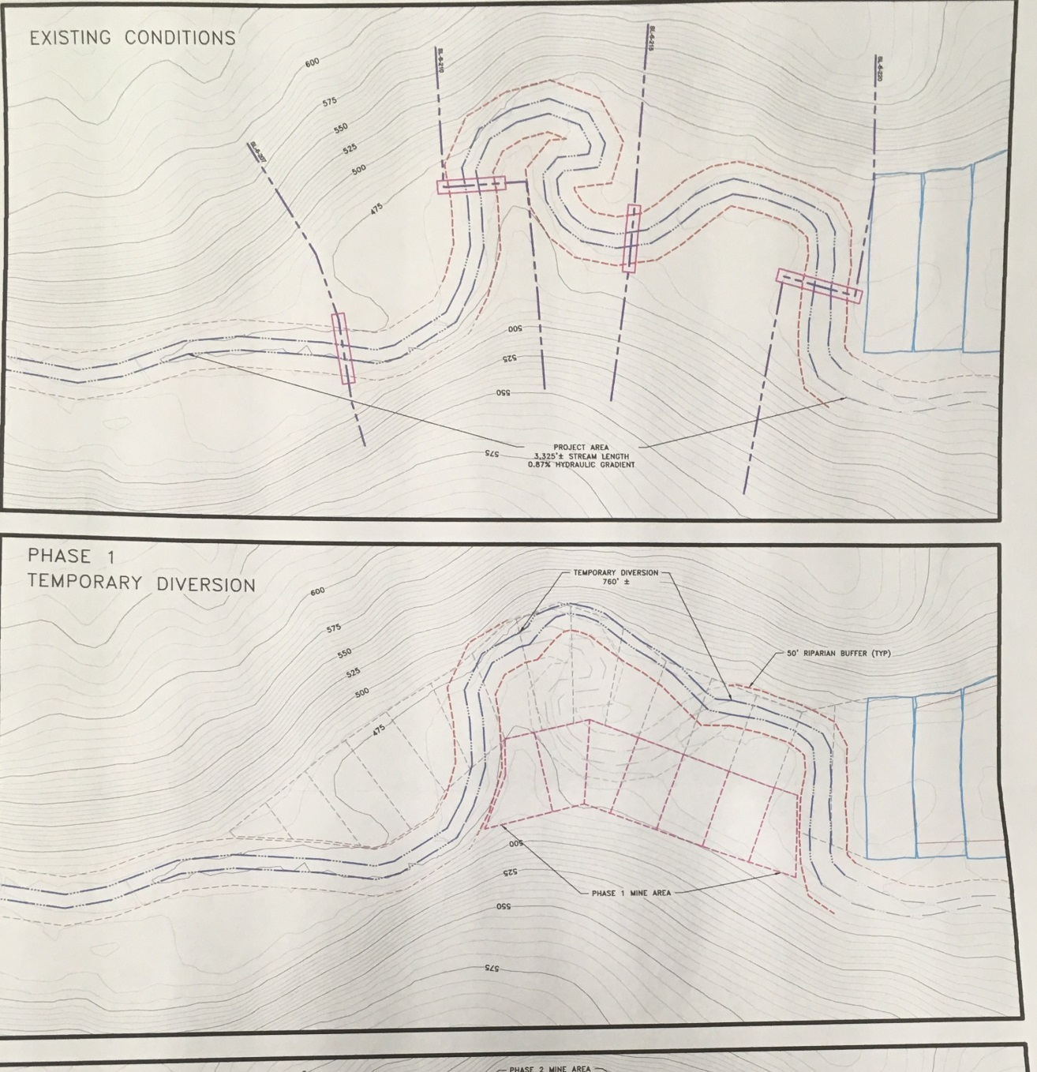
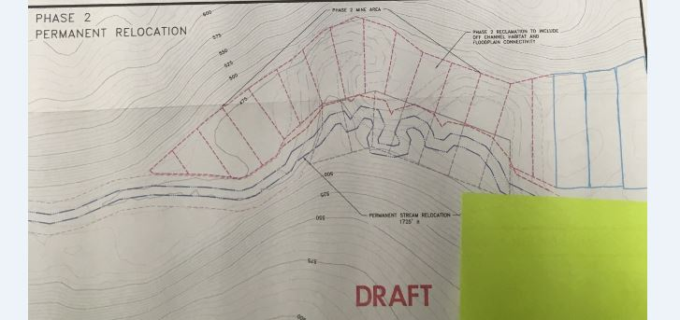
Notes:
Original channel & proposed work

Slide 32
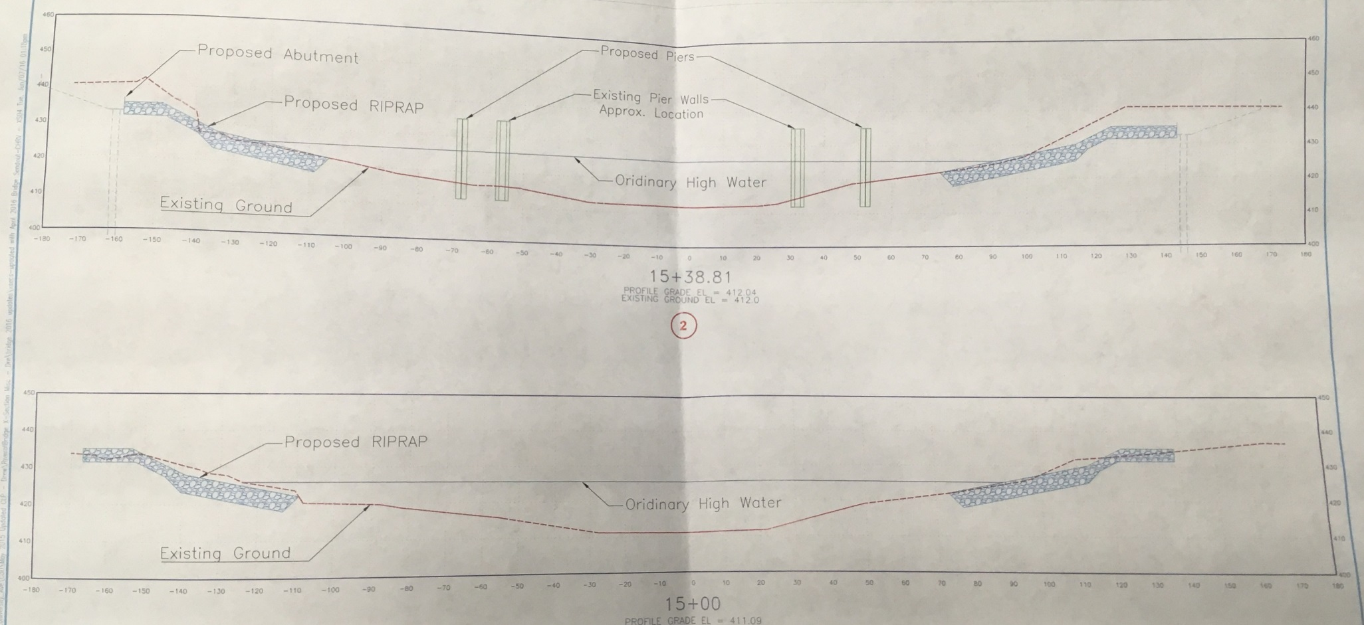
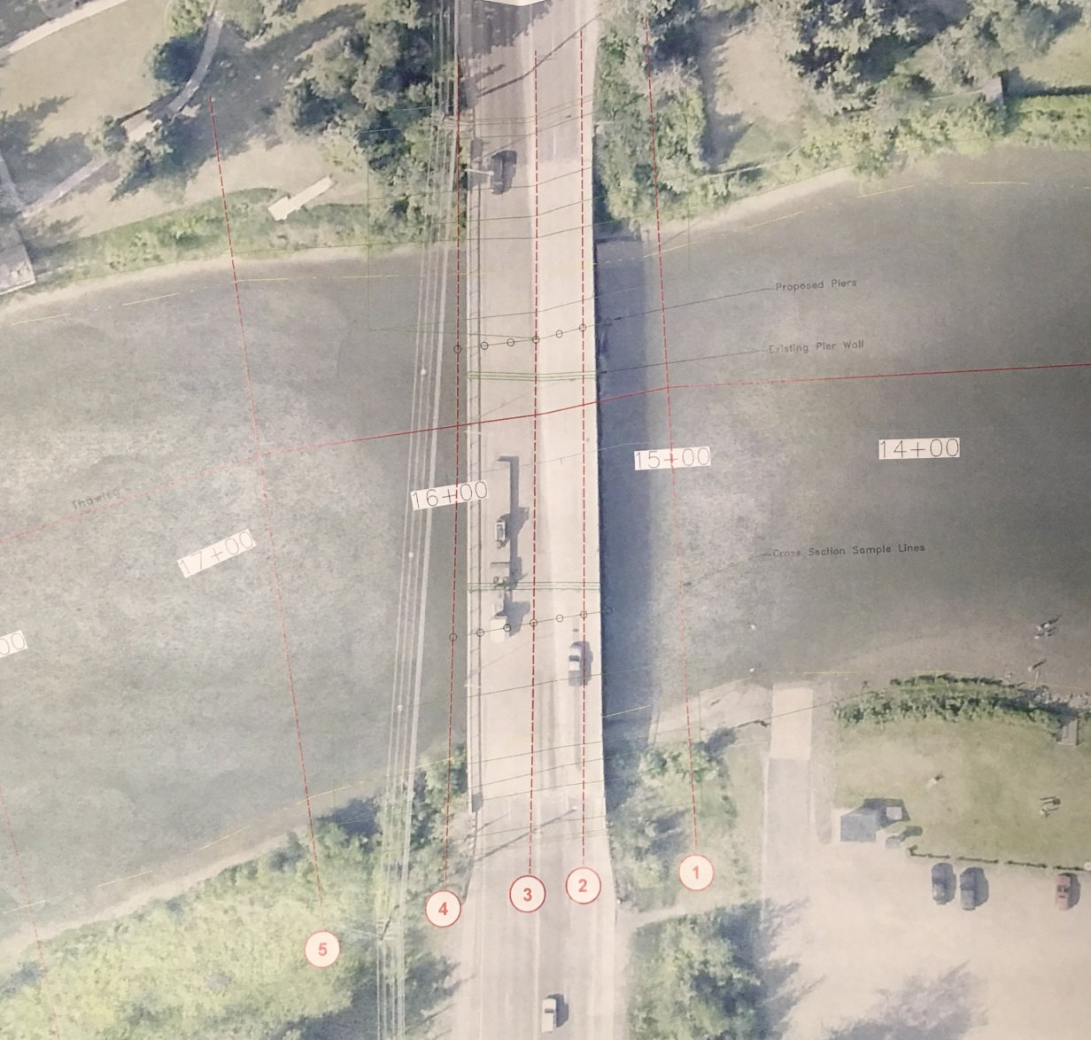
Notes:
Shows original piers & new ones
Extent of work
Stream bed contours

Slide 33
Step 3 – Draft Permit
Habitat Biologist (HB) drafts the permit
If nothing is known about the waterbody, HB may conduct site visit to assess fish presence/ other issues (perched culverts, previous damage, mitigation potential, etc..)
If HB has questions and/or concerns about application they will contact applicant to clarify questions and/ or address concerns

Slide 34
Step 3 – Draft Permit (cont.)
If there are problems that cannot be resolved, the applicant may amend or withdraw their application; or ADF&G may deny it
If there are no problems, or the applicant is open to changes to their scope of work to ensure FISH PASSAGE and/ or MINIMAL IMPACTS to the stream, the permit will be issued

Slide 35
Step 4 – Permit Issued
Permit is issued, distributed via email (occasionally snail mail)
Often issued w/ Stipulations: timing windows to avoid spawning/migration, revegetation/ stabilization requirements, breaching ice bridges, screening water intakes, notifying local staff prior to work start
Check it over, ensure there are no errors & then print a copy (or 2, or 3) to keep on site

Slide 36
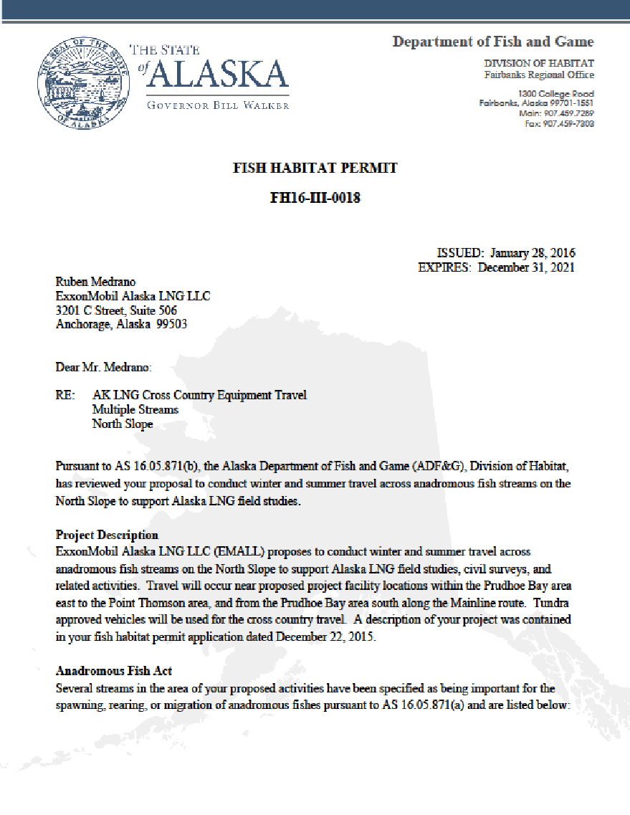
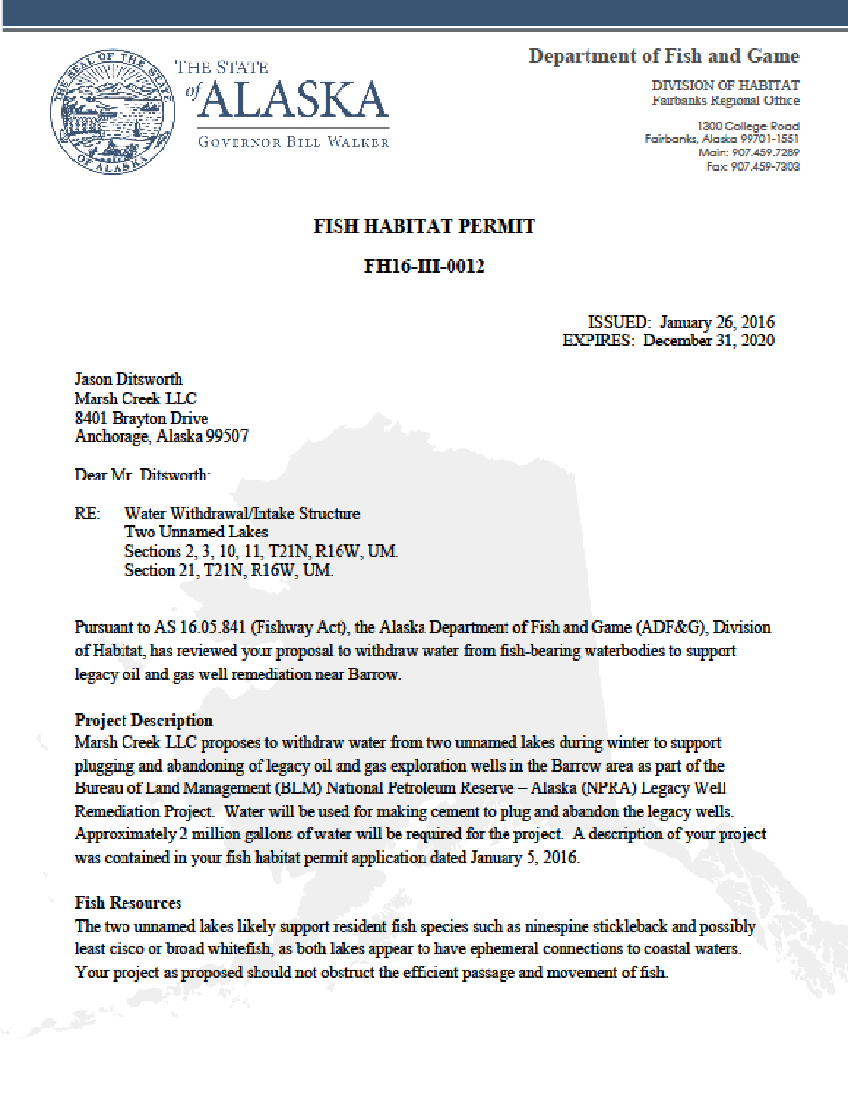
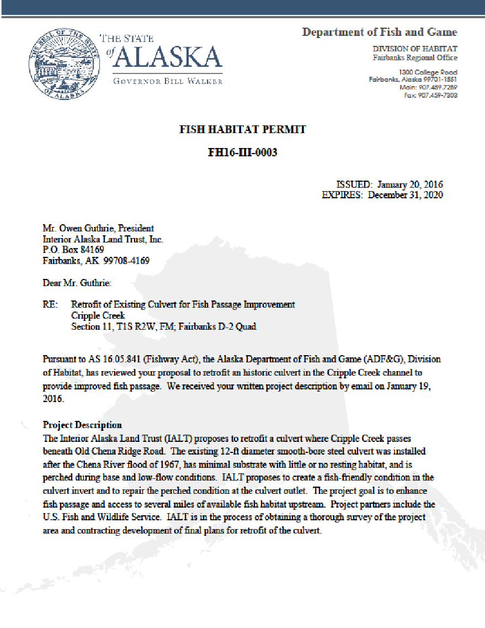
Notes:
Must have onsite & permit holder is responsible for any contractors.

Slide 37
Step 5 – Follow Up, Site Visits
ADF&G may visit the work site to ensure permit conditions are being followed
Photos (ground & air (drones)).
Fish sampling.
Inspect gear (screening on water intakes)
Possible long tern biomonitoring for large projects.

Slide 38
Exceptions
Emergency Authorizations!
Road/ Bridge damage
Threatened infrastructure
Call us immediately & we will verbally authorize the work over the phone (usually followed by an email) and we will process paper wok and any necessary mitigation after-the-fact

Slide 39
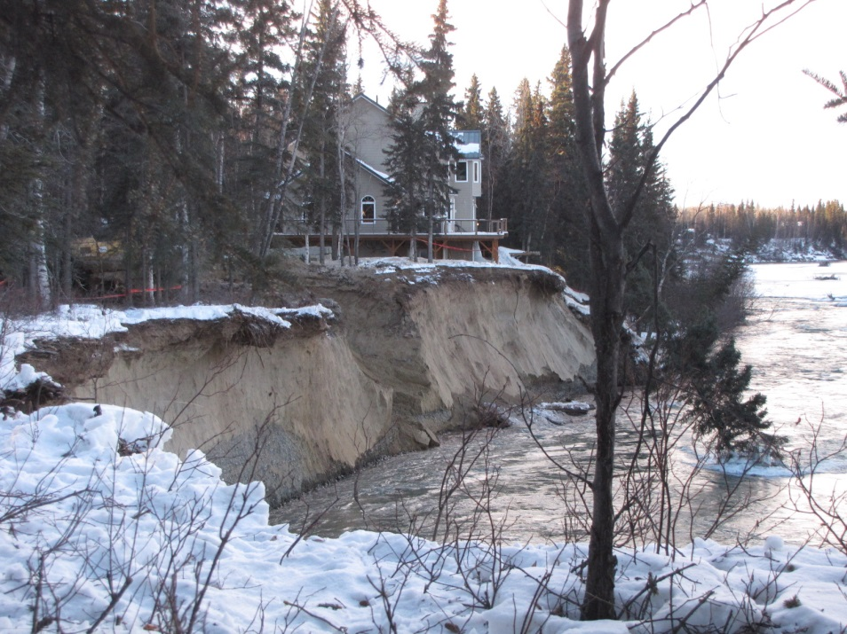
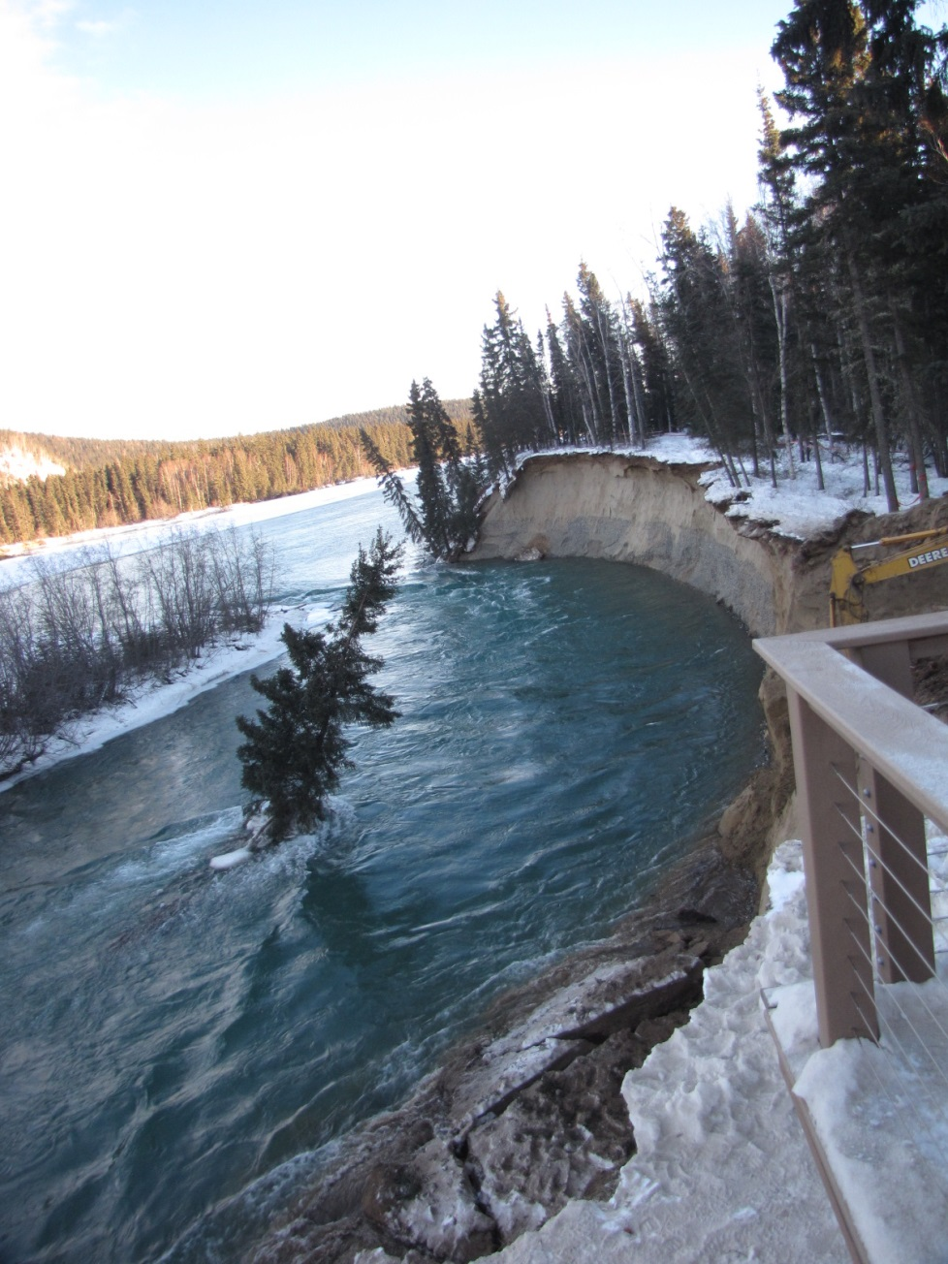
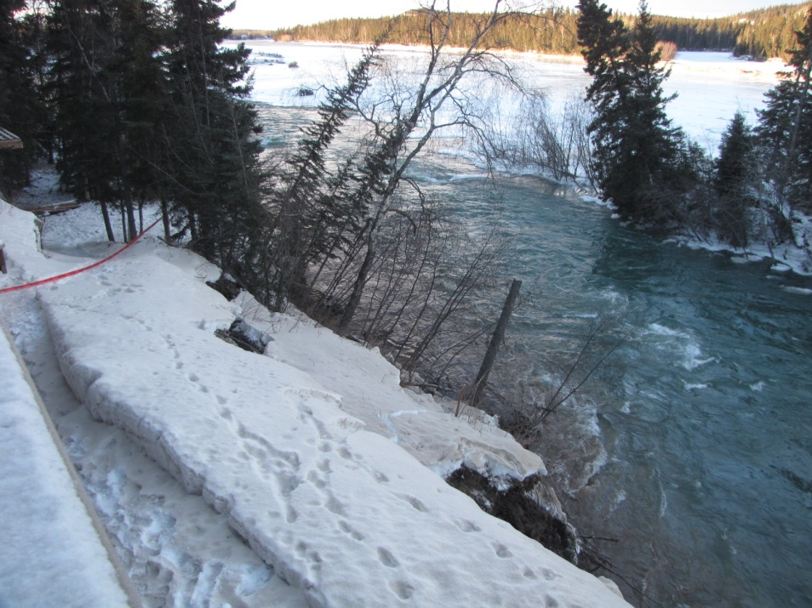

Slide 40
General Habitat Permitting Process
Large projects have multiple pre-application meetings and site visits.
Habitat participates in other federal/state and municipal permitting processes.
Notes:
Large Projects – DOT bridges, Large Mines, Oil & Gas – these have a public process component & bring in EIS & EA….multi year.
On site work & long term monitoring of large projects.
We comment on multiple projects:
DNR land use permits, Army Corps (wetland fill), DNR APMA (placer mine), ADEC (discharge permits), ADOT project planning, Borough planning/ development

Slide 41
Enforcement
Letter of noncompliance, notice of violation.
Misdemeanor.
Mandatory Court Appearance.
On your record.
You are responsible for contractor’s actions.

Slide 42
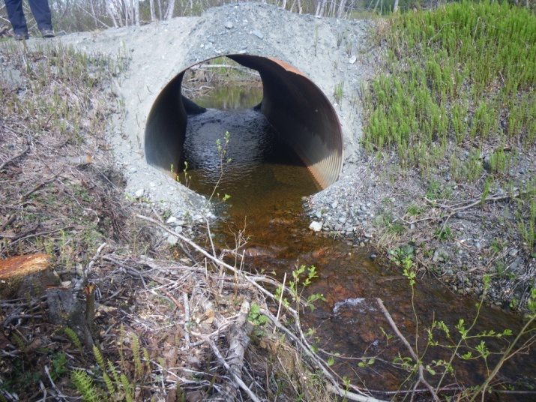
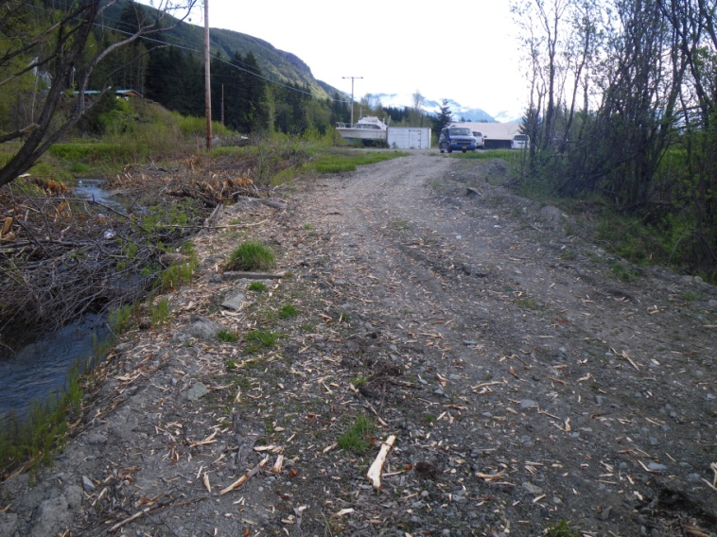
Title 16 (.871): Unauthorized activities
excavation
boat launches
culverts
equipment
stream diversion
Notes:
These are a few pictures of unauthorized activities we occasionally see in the field.

Slide 43
By the numbers… (July 1, 2015 – June 30, 2016)
25 Habitat Biologists statewide
Issued 1,902 Fish Habitat Permits
1,229 permits were .871 (anadromous)
525 permits were .841 (fish passage)
Average review time 4 days
Issued 140 Special Area Permits
Average review time 11 days
Issued 8 Emergency Authorizations
Notes:
Placer related (rec & commercial) (900)
Culverts (130)
Bank stabilization (100)
Oil & Gas (90)
Debris removal (80)
Bridges (75)

Slide 44
Examples of Permitted Projects

Slide 45
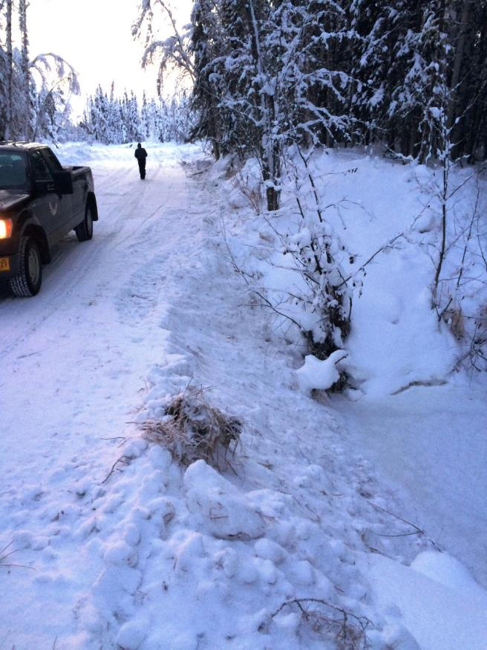
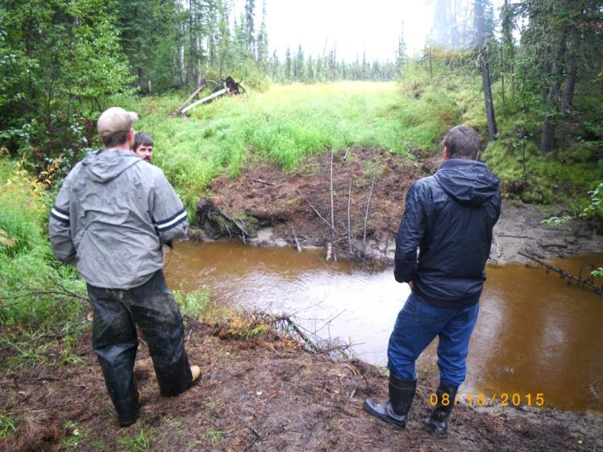
Ice Bridges (841)
Notes:
Smallwood Creek (resident fish only)

Slide 46
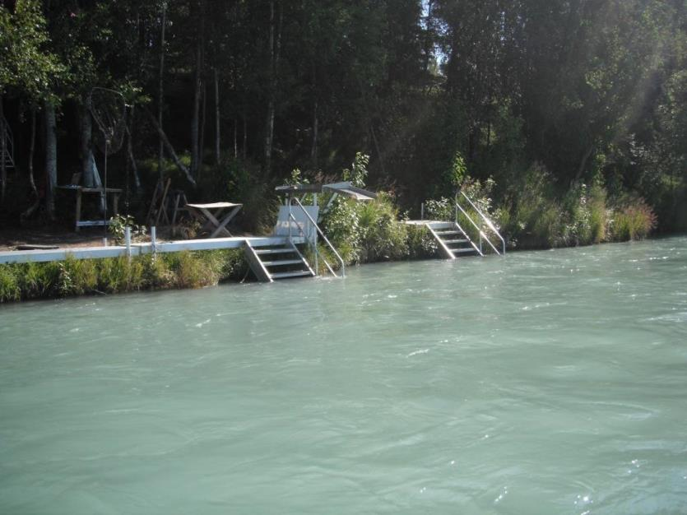
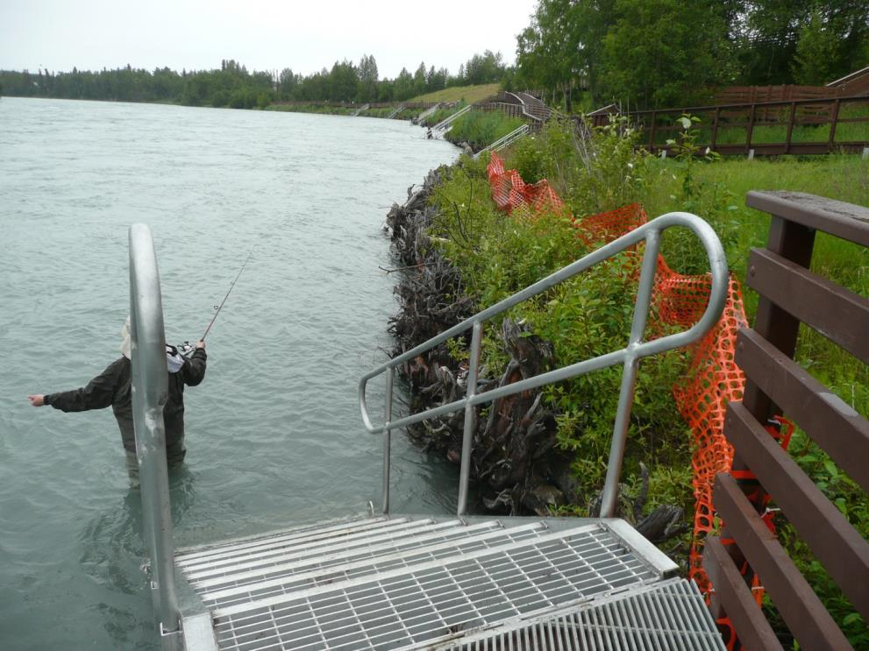
Bank Rehab & Docks (871)
Notes:
Kenai River bank rehabilitation projects & docks
About 10 years after rehab

Slide 47
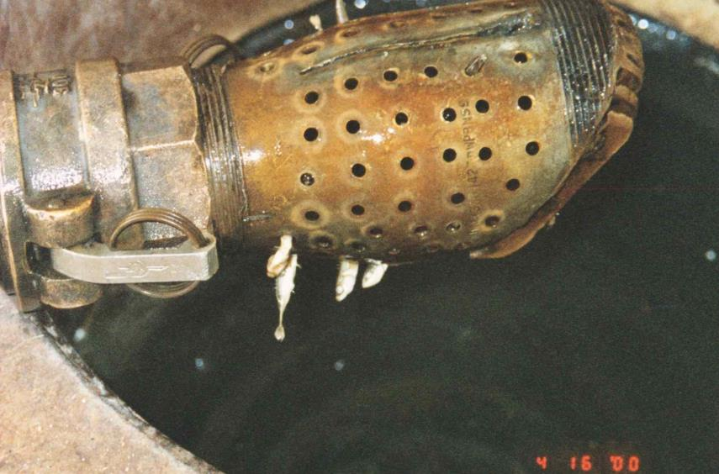
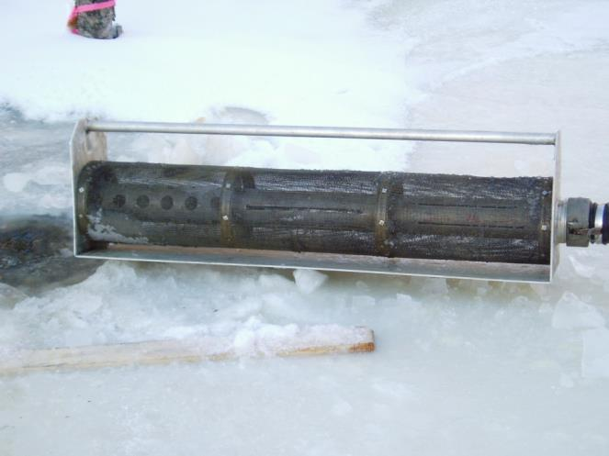
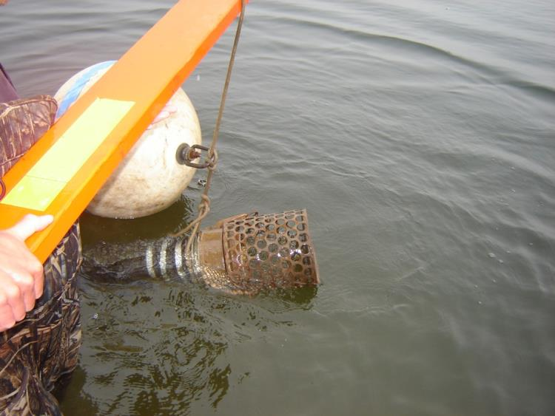
Water Intake Screens (871)
Notes:
Left ones were bad, too small for the velocity removal. The one on the right is a standard water intake for high volume/ velocity removals
Standard Stipulation: Water intake structures designed to prevent the intake, impingement, and/or entrapment of fish shall be installed and maintained at each water intake location. The effective screen openings may not exceed 0.25 inches (1/4 inch). To reduce fish impingement on screened surfaces, water velocity at the screen/water interface shall not exceed 0.5 feet per second when the pump is operating.
For detailed information regarding screened intake device design please consult our webpage & Technical Report No. 97-8
Plastic bag held close to intake does not get sucked in, juvenile coho can swim next to a properly designed intake.

Slide 48
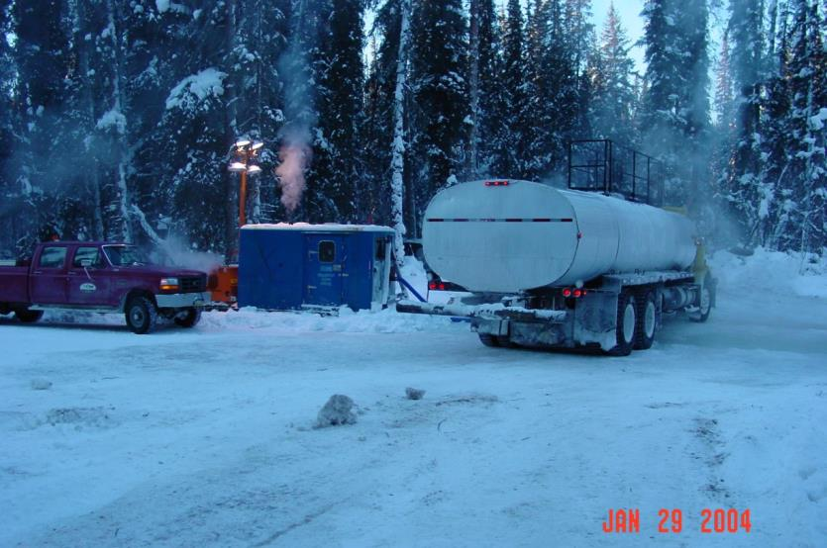
Ice Bridges (871)
Notes:
Nenana & Goodpaster Rivers
Intakes were both screened (tie into previous)

Slide 49
Channel Diversion (871)
Notes:
The log jam photos (Resurrection Creek in Hope) includes a picture of a cabin in danger of falling into the river after the river changed direction. The new direction also put the Hope Road Bridge into jeopardy. The second photo is of a manufactured log jam to divert the flow back into the original channel.

Slide 50
Questions?
Audra Brase
ADF&G Habitat
Fairbanks
(907) 459-7282
audra.brase@alaska.gov
Notes:
Questions?

